Slide 1
Rating Hospital Performance
Brining Consumerism to Healthcare
June 5th, 2019
Presenters: Marin Gow, Michael Diarra, Venku Buragadda, Zain Iqbal & Zain Jafri

Slide 2





Agenda & Presentation Outline
Background & Problem Statement
Data Overview & Exploration
Data Preparation & Feature Extraction
Modeling Approach & Evaluation
Challenges, Recommendations & Future Opportunities

Slide 3





Consumerism Is Everywhere
In nearly every industry and sector, consumer power has grown in the last 10 years as the availability of data has given consumers previously unknown levels of transparency into the quality of goods and services provided.

Slide 4

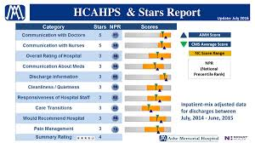
Except for the Healthcare Industry
The need and opportunity is there…
…significant investment has been made…²
…major challenges still exist in driving improved quality
Each year 1.7M Americans develop hospital acquired infections¹
Approximately 99,000 of those patients die¹
Many of these cases are considered preventable
Variation in health outcomes is a major driver
Data collection and reporting is not timely – often lagging 1-3 years (depending on the data set)
Reporting is not easy for consumers to access and interpret
Stakeholder incentives are often not aligned
Notes: 1) Alliance for Aging Research; 2) Centers for Medicare & Medicaid Services.

Slide 5
Problem Statement
Our goal is to develop a model to predict the Quality Performance of a hospital, using the HCAHPS Patient Survey and Complications & Deaths data sets.
We explored both classification and regression models to predict the Hospital Star Rating or Overall Recommend Score (respectively).
Ultimately, we believe this can be used to create a more real-time application patients can use to determine which hospitals they utilize for non-emergency care.¹
Notes: 1) Further discussed in the Recommendations section of our presentation.

Slide 6
Selected Datasets
Center for Medicare Services
Data source
CMS is the government body that runs Medicare and Medicaid and audits the performance of U.S. hospitals and healthcare organizations.
Target Variables
Star Rating
Complications and Deaths
Dataset - predictors
Dataset of various types of complications and deaths that have occurred at each U.S. hospital, expressed as count per thousand. Examples include bedsores and deaths from complications post surgery.
Recommended Linear Score
Patient Survey Scores
Dataset – predictors and target
87
Dataset of survey scores received by hospitals from patients. Survey covers topics such as cleanliness and nurse communication.
Notes:
This goes before data exploration

Slide 7
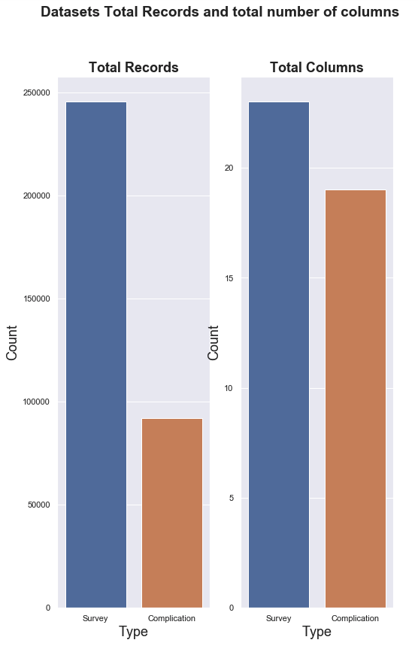
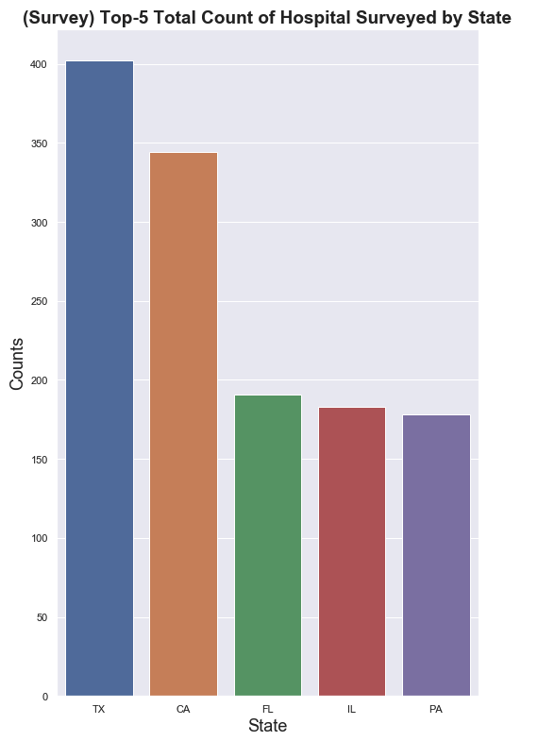

Data Overview & Exploration

Slide 8
Data Overview & Exploration
Survey Data:
Complication Data:
HCAHPS Question | HCAHPS Measure ID
Communication about medicines - linear mean score | H_COMP_5_LINEAR_SCORE
Cleanliness - linear mean score | H_CLEAN_LINEAR_SCORE
Recommend hospital - linear mean score | H_RECMND_LINEAR_SCORE
Care transition - linear mean score | H_COMP_7_LINEAR_SCORE
Overall hospital rating - linear mean score | H_HSP_RATING_LINEAR_SCORE
Doctor communication - linear mean score | H_COMP_2_LINEAR_SCORE
Nurse communication - linear mean score | H_COMP_1_LINEAR_SCORE
Discharge information - linear mean score | H_COMP_6_LINEAR_SCORE
Staff responsiveness - linear mean score | H_COMP_3_LINEAR_SCORE
Quietness - linear mean score | H_QUIET_LINEAR_SCORE
Measure Name | Measure ID
Rate of complications for hip/knee replacement patients | COMP_HIP_KNEE
Death rate for heart attack patients | MORT_30_AMI
Death rate for CABG surgery patients | MORT_30_CABG
Death rate for COPD patients | MORT_30_COPD
Death rate for heart failure patients | MORT_30_HF
Death rate for pneumonia patients | MORT_30_PN
Death rate for stroke patients | MORT_30_STK
Postoperative Acute Kidney Injury Requiring Dialysis Rate | PSI_10_POST_KIDNEY
Postoperative Respiratory Failure Rate | PSI_11_POST_RESP
Serious blood clots after surgery | PSI_12_POSTOP_PULMEMB_DVT
Blood stream infection after surgery | PSI_13_POST_SEPSIS
A wound that splits open after surgery on the abdomen or pelvis | PSI_14_POSTOP_DEHIS
Accidental cuts and tears from medical treatment | PSI_15_ACC_LAC
Pressure sores | PSI_3_ULCER
Deaths among Patients with Serious Treatable Complications after Surgery | PSI_4_SURG_COMP
Collapsed lung due to medical treatment | PSI_6_IAT_PTX
Broken hip from a fall after surgery | PSI_8_POST_HIP
Perioperative Hemorrhage or Hematoma Rate | PSI_9_POST_HEM
Serious complications | PSI_90_SAFETY

Slide 9
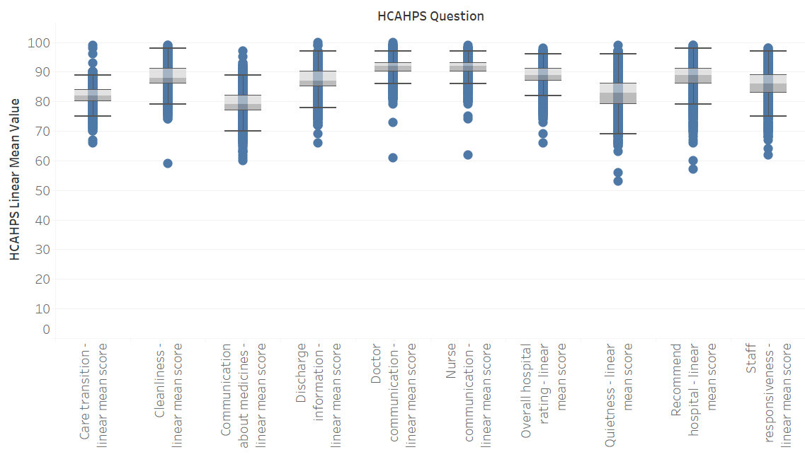
Data Overview & Exploration
Survey dataset- HCAHPS question vs Linear Mean values boxplot:

Slide 10
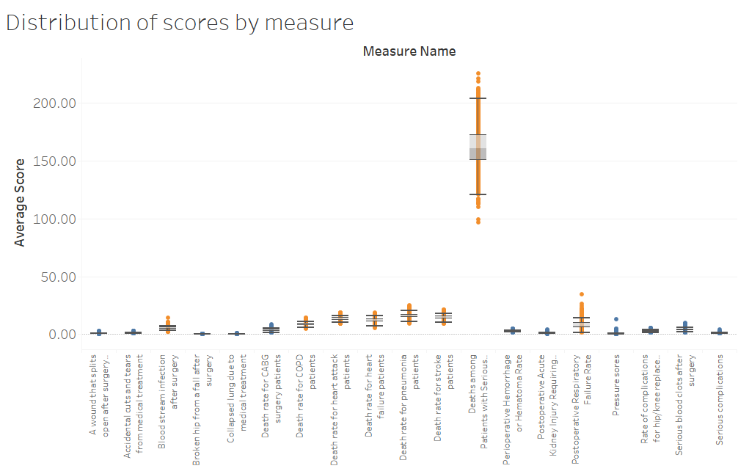
Data Overview & Exploration
Complication dataset- Measure and the Scores boxplot:

Slide 11
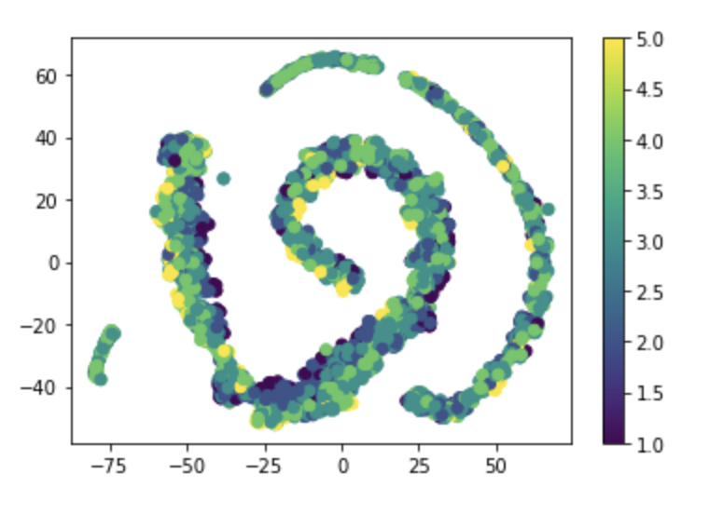
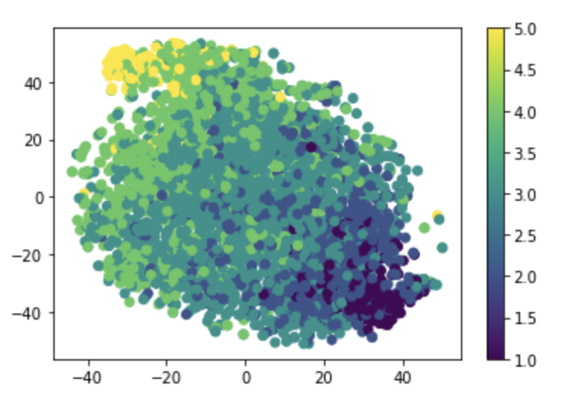
Data Overview & Exploration
t-SNE without standardization of data
t-SNE with standardization of data

Slide 12
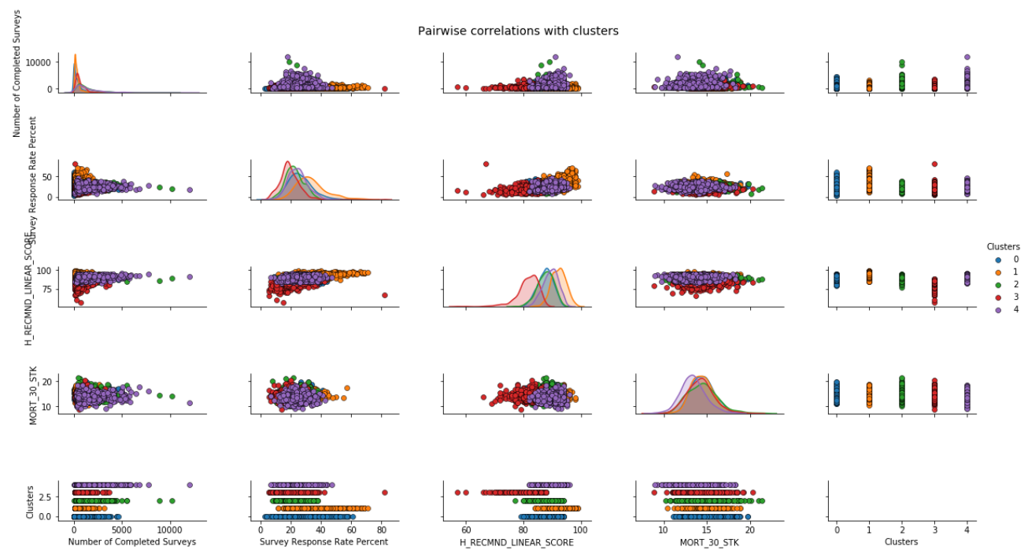
Data Overview & Exploration
Pairwise correlations with clusters

Slide 13
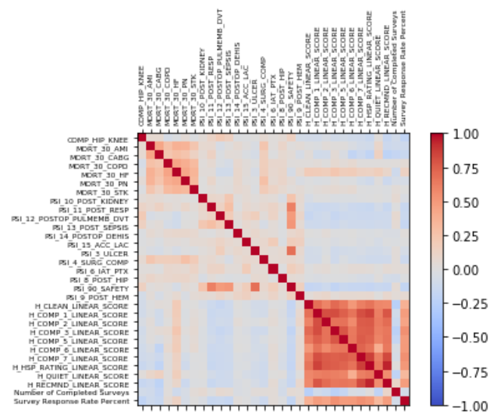
Data Preparation
Unpivoted survey data
Combined datasets using shared Provider ID
Dropped high cardinality features such as zip code

Slide 14
Imputation
Three imputation methods:
Mean
Linear Regression
KNN
Each imputation method was tested across all 12 of our models
Linear Regression performed best across most of our models

Slide 15
Evaluation of Models – Overview of Models Run
Thirty-three model runs on three separate datasets
Seven classification models and four regression models
Pre-selected Gradient Boosted Classifier based on the model high Accuracy, Precision, Recall, and F1 Score

Slide 16
Validating the Accuracy Score – Gradient Boosted Classification
k-Fold Cross-Validation is a resampling procedure used to evaluate machine learning models on a limited data sample.
We ran a 10-fold cross-validation on the entire dataset to estimate the skill of a machine learning model on unseen data.
We observed that the accuracy scores were high and reasonably consistent from fold to fold
We further noted a high mean accuracy score with a low standard deviation
We concluded that the model accuracy score number was reliable

Slide 17
Checking for Overfitting – Gradient Boosted Classifier
We ran a 10 folds cross validation on the complete dataset, the test dataset, and the training datasets.
We further compared the cross-validation results to ensure their consistency, thus that the model was not overfitting
We concluded, based on the differences between 10-fold CV mean scores, and the related standard deviations that the likelihood of our model overfitting was low.

Slide 18
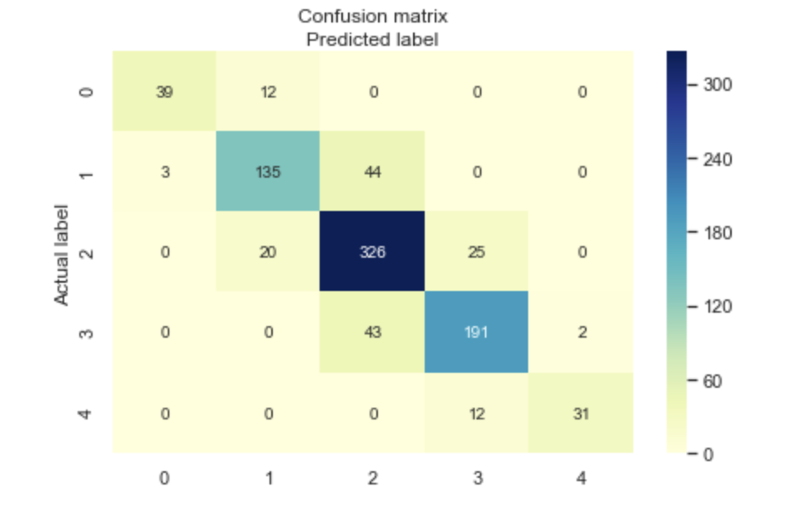
Checking for Accuracy Paradox – Gradient Boosted Classifier
The accuracy paradox is the paradoxical finding that accuracy is not a good metric for predictive models when classifying in predictive analytics.
We checked for the accuracy paradox by running a confusion matrix and a Sklearn classification report. A confusion matrix is a summary of prediction results on a classification problem.
We concluded that our Gradient Boosted Classifier was not victim of the Accuracy Paradox based on the high recall, high precision and high F1 score values shown in classification report, as well as the low number of false positives and false negatives shown in the confusion matrix

Slide 19
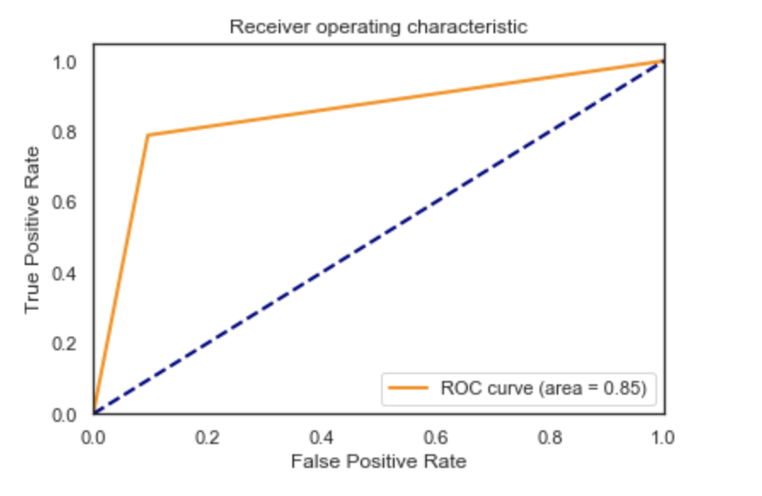
Checking for Classification Ability – Gradient Boosted Classifier
ROC is a probability curve and AUC represents degree or measure of separability. It tells how much model is capable of distinguishing between classes. Higher the AUC, better the model is.
We concluded that our model has a reasonably good classification ability based on 85% probability of correct classification shown in the ROC AUC plot

Slide 20
Recommendations
Using Hospital Complication Scores and Patient Surveys the selected Gradient Boosted Classification model predicts Hospital Rating Scores with the highest accuracy
The recommended will allow for a more timely application patients can use to determine which hospitals they utilize for non-emergency care
Rating scores include actual hospital performance and patient survey feedback rather than just patient survey data from CMS
Hospital Complication Scores
Patient Ratings
Gradient Boosted Classification
Predict Score Rating

Slide 21
Challenges
Missing Values: Roughly 5% of the total dataset had missing values – team explored three imputation methods to fill missing data – Mean, KNN, and Regression
Over fitting / Under fitting: Random Forest Classification and some Regression models resulted in over fitting. While we adjusted the models parameters to ensure the difference in accuracy between testing and training cross validation was insignificant, we ultimately selected a classification model that was not overfitting.
Clustering: The team applied various unsupervised learning methods such as k-means, DBSCAN, and hierarchical clustering, however none of the models were valuable for the selected model.
Data Lag: CMS reporting data contains a 1-3 year reporting lag time - the model was fit on data valued as of July 1, 2017.

Slide 22
Model Improvements
Example Hospital Network
Graph Model Ranking: Model can be improved by adding hospital features to develop accurate edges and nodes for a hospital rank recommendation
Complication Scores Limitation: CMS complications scores only include 20 different complication types – with additional complications the model can predict better rating scores and provide more accurate recommendations based on patients’ current complication

